Slide 1
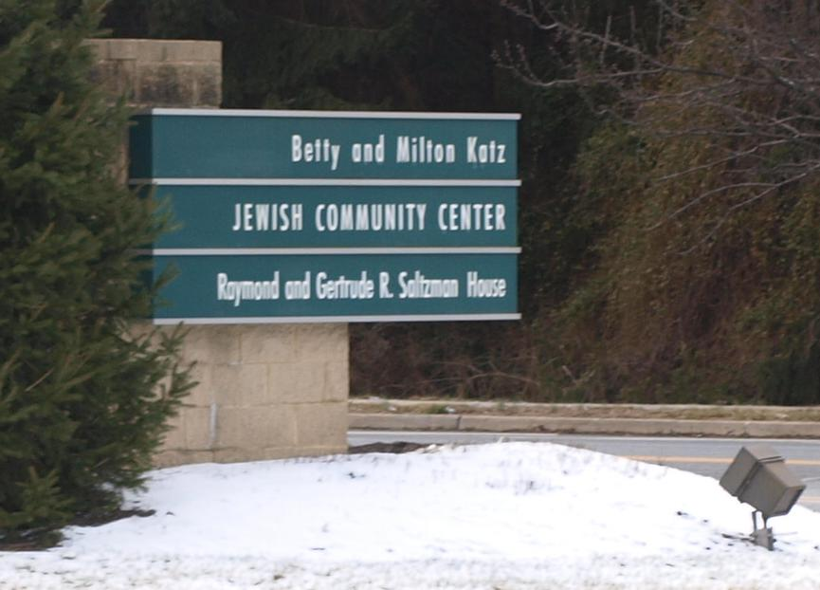
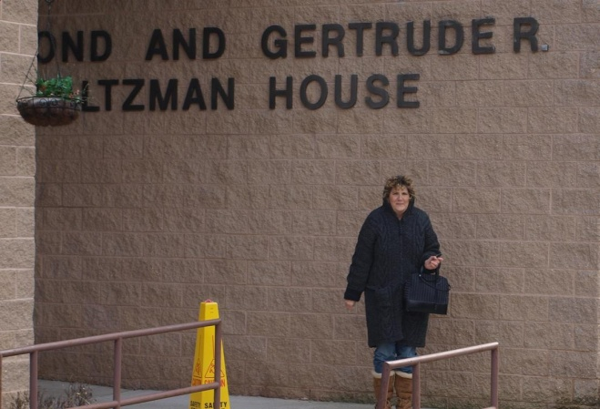
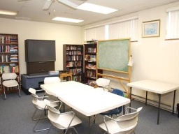
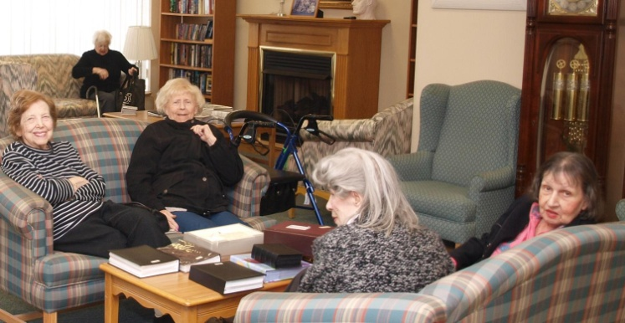
Sashaying at the Saltzman House
This slide show presents the Cherry Hill field trip to the Saltzman House
Below are several photos of the facility both from the outside and inside

Slide 2
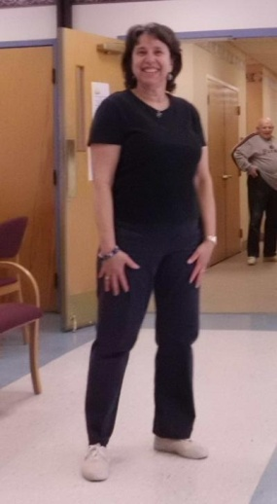
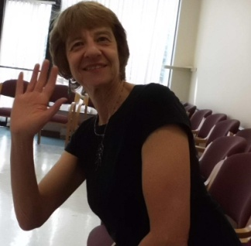
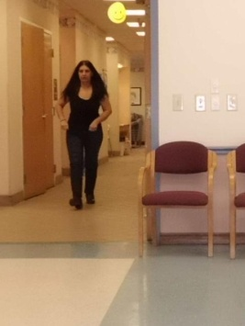
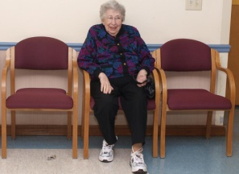
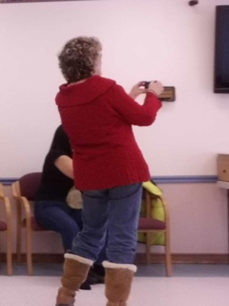
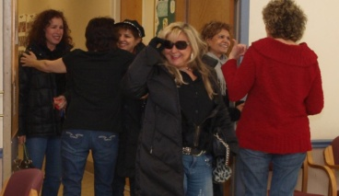
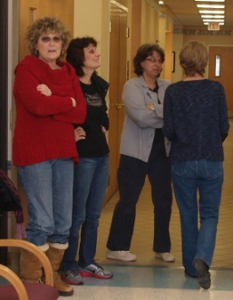
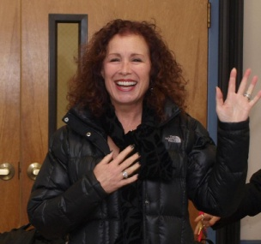
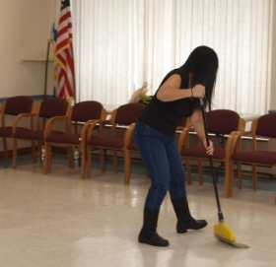
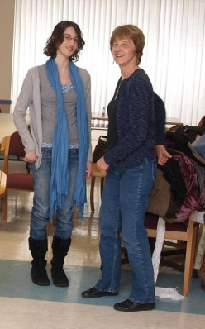
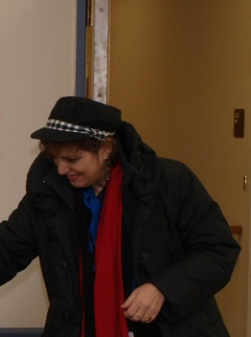
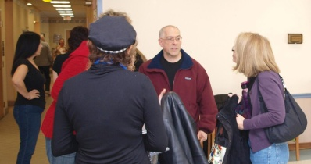
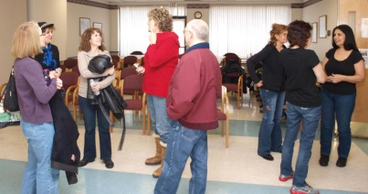
This performance won’t go far without performers and they are in the process of arriving. These volunteers are coming from South Jersey, Philadelphia, Valley Forge, Bala Cynwyd, Princeton and Northern New Jersey. All take time out of a busy schedule to perform this Sunday afternoon

Slide 3
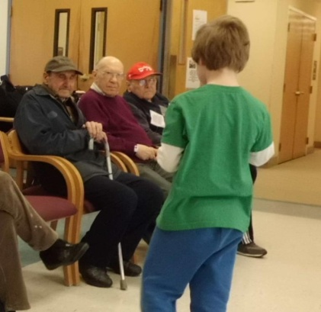
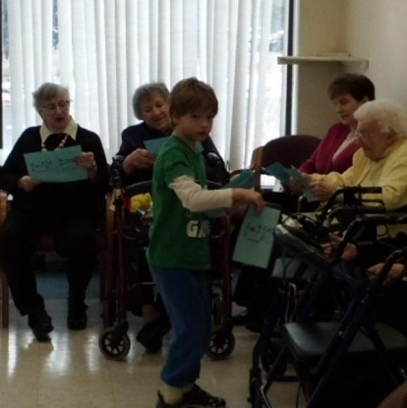
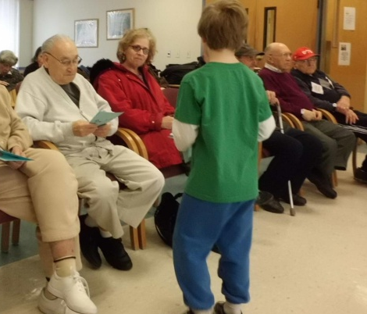
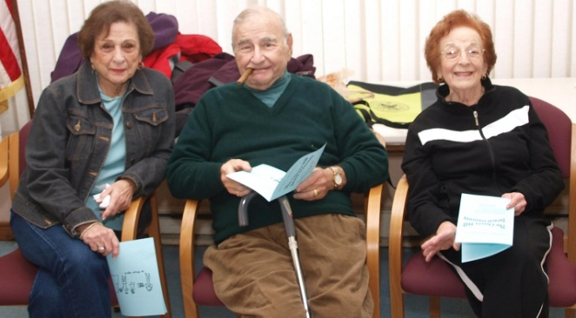
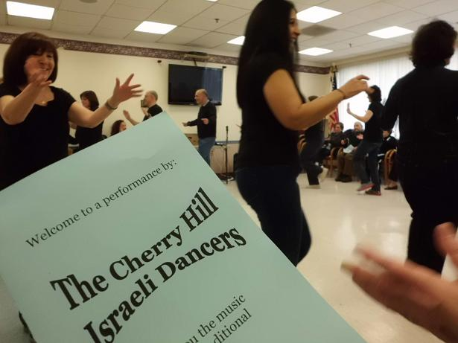
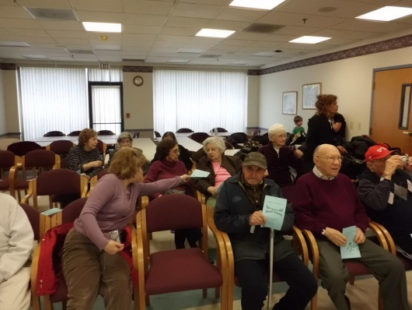
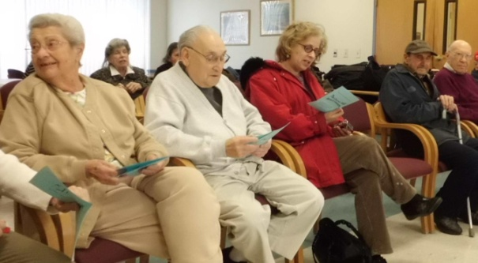
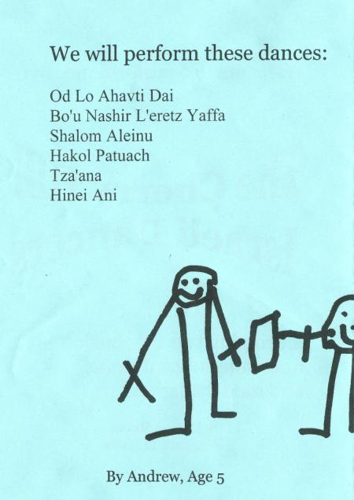
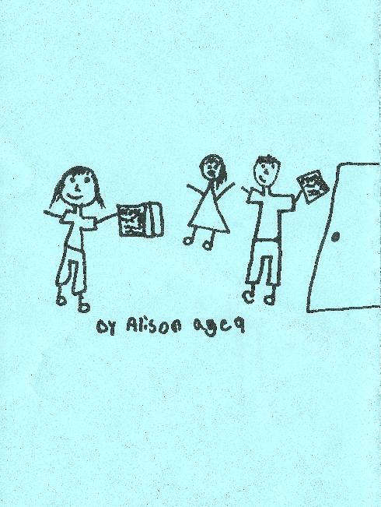
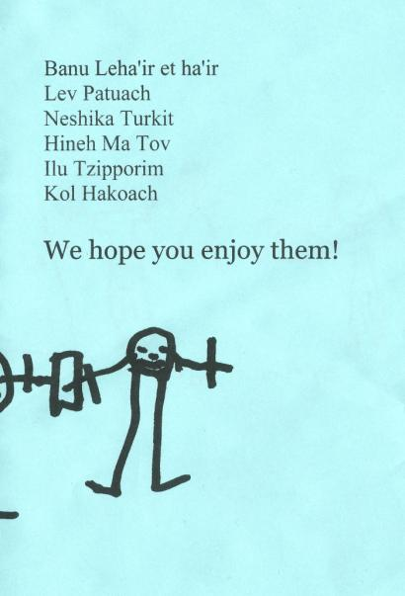
An important component of the performance is the programs detailing the performance. Here we see the creator of this word document handing out his creation to the amassing audience
The residents are interested in what is to be performed. Below, you see the programs being read for this purpose.
Below, you now have a Bird’s eye view of the handout

Slide 4
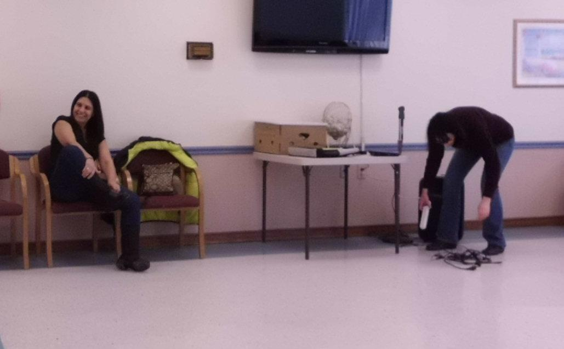
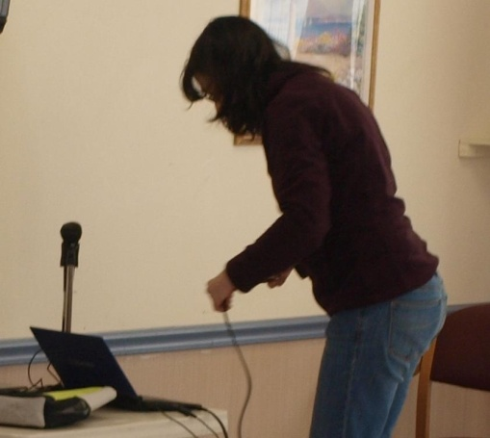
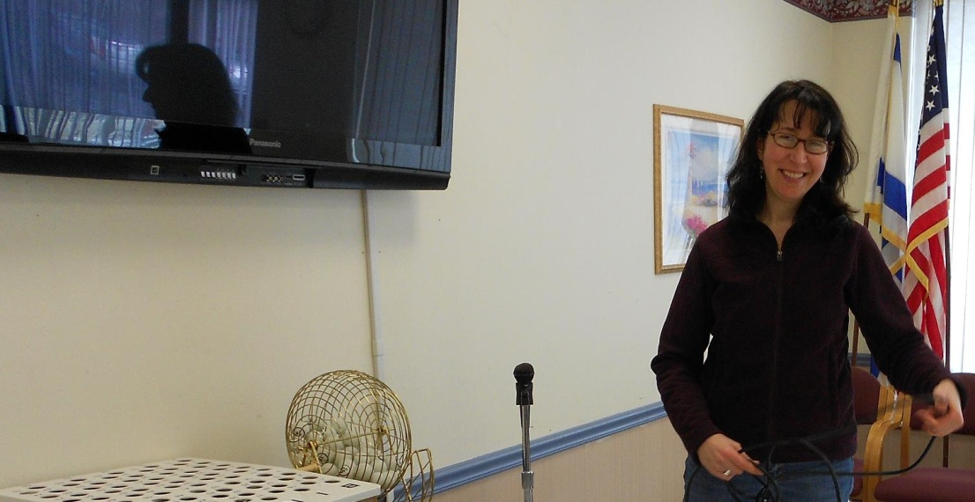
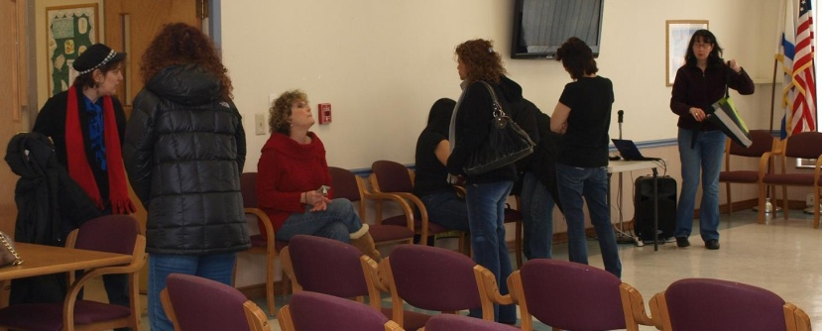
While the programs are being handed out and the residents and performers are amassing, the leader of this activity, Naomi, tends to her equipment.
150 years ago, these performers would be accompanied by live musicians
80 years ago, there would be a victrola to play records
45 years ago we would see a 45 rpm record player
15 years ago, a CD player would be in operation
Today, a computer, or a mp3 player such as an Ipod, is the order of the day and we see Naomi stringing connectors between her laptop and amplifier.

Slide 5
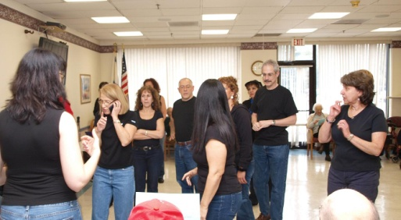
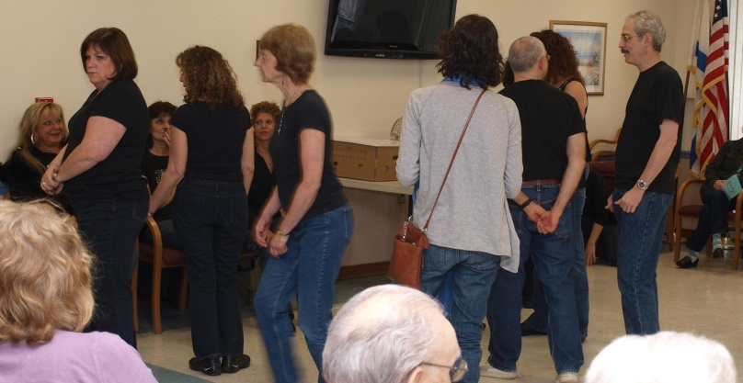
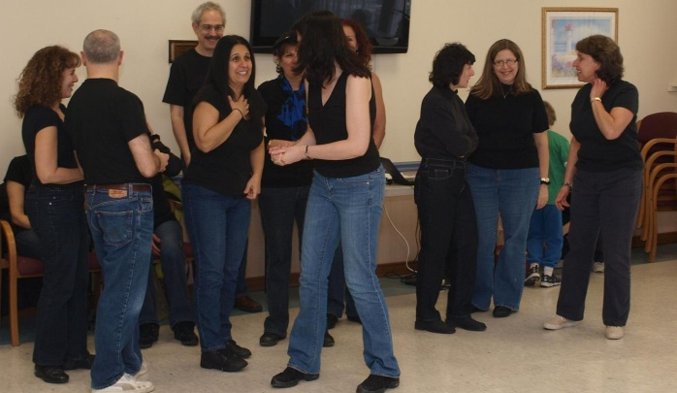
It is a few minutes to 3PM. Naomi calls a meeting of her dancers. She goes over the list of dances to be performed giving last minute instructions (possibly reminders) to how they are to be danced. At the end, she demands of her dancers to:
Smile, Smile, Smile
Dance with uniformity (within the bounds of neighboring dancers
If not knowing a dance, take pictures on the sidelines
Smile, Smile, Smile

Slide 6
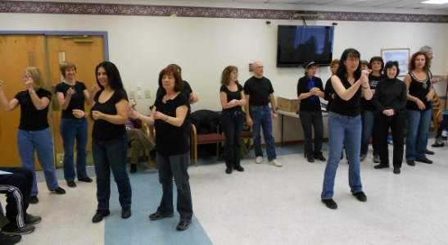
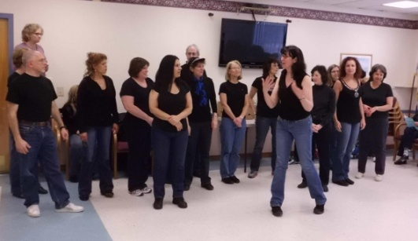
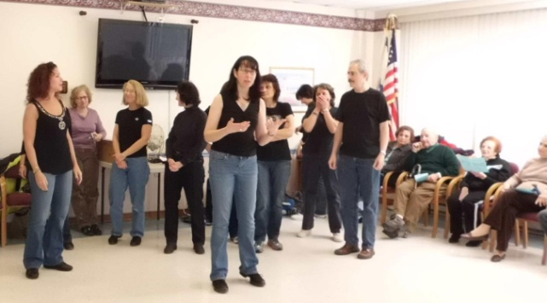
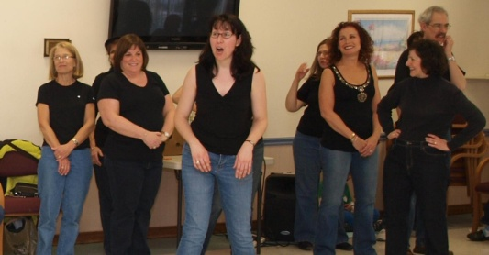
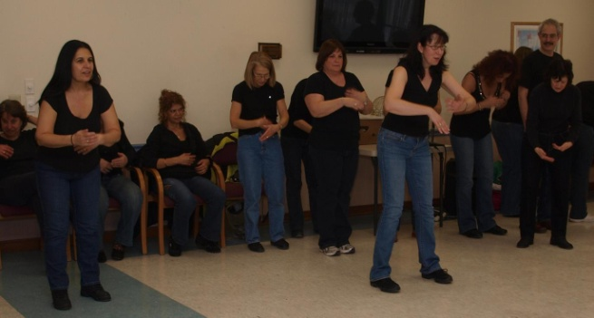
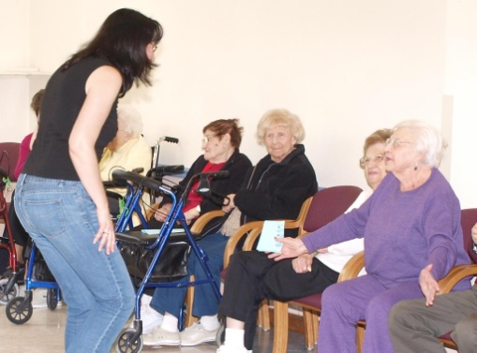
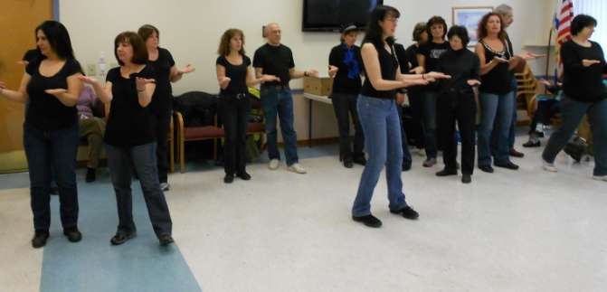
Throughout the performance, The leader, Naomi will introduce the dances performed. Additionally, at the start, she will introduce the group.
Amazingly, her discussions with the audience are very well received to the point that the audience, both male and female, seem mesmerized. You can hear a pin drop. She brings a passion, a knowledge of psychology and a pleasing personality into this.
This combination is rare. Obviously, your instructor has proved to you through the course of this term that he does not have these talents.

Slide 7
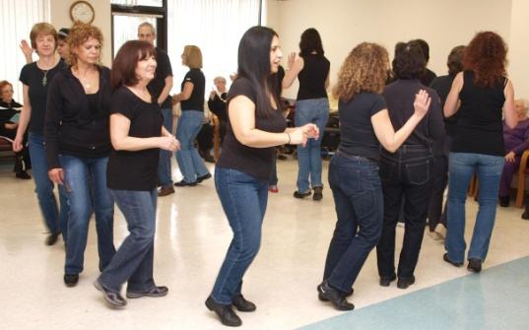
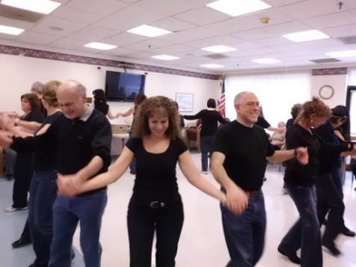
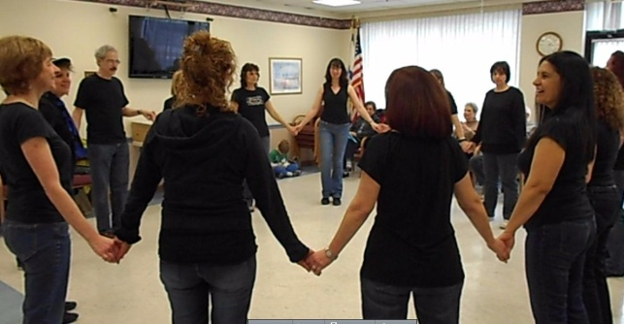
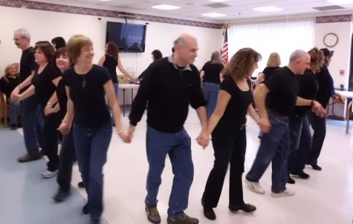
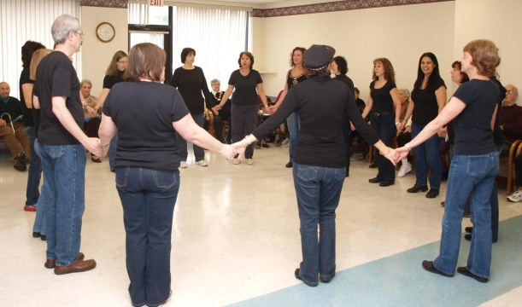
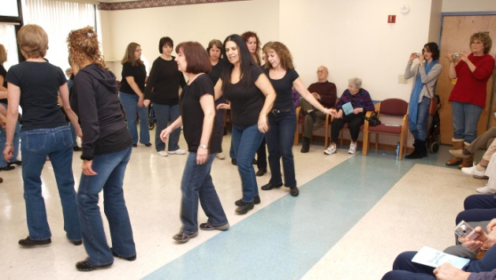
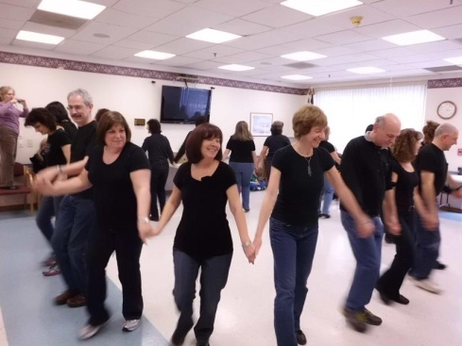
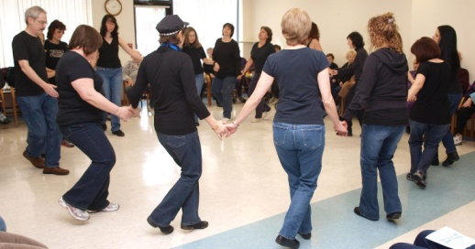
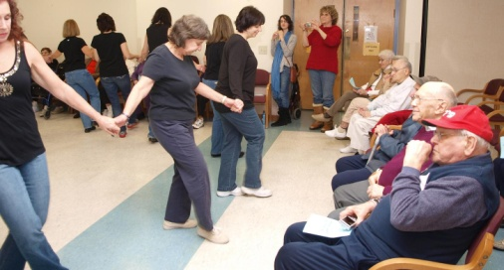
Naomi has primed her troops. She has also instructed the audience. It is time to dance. The first dance is Od Lo Ahavti Dai. Someone has told your instructor that the translation of the words sung are the biggest male copout for not continuing a relationship with a specific woman.
Of course the dancers aren’t interested. Especially those who do not understand the language of the words. What they are insterested in is to dance and so they line up ready to start this afternoon performance
The dancers start their motions. This is a circle dance and the choreographer has set the dance to start counter clockwise.
This dance is one of the first dances that novices to this art form learn. It has a nice beat but the steps are pretty simple. The dancers face each other in a circle. The steps repeat 3 times, but Naomi has a surprise.
With the 3rd repetition, the dancers are supposed to turn 180 degrees and dance at the audience
These final pictures on this slide show the last rendition. The dancers are moving back and forth to the audience.
Naomi has several instances of this to bring the audience into the performance and these work quite well as there is almost no instance where the group is not invited back

Slide 8
Israel dance is broken into several subsets: line, circle and partner. One of the line dances, Turkish Kiss, has exaggerated arm and hand movements. Naomi brings the audience into the performance by priming them to participate in these movements as you can see above
The residents respond in kind. These picture show and fade into other pictures showing the audience practicing the arm movements

Slide 9
Now, it’s the dancers turn. Line dances are generally done in a checkerboard pattern as you may be able to see in these pictures.
The dance that’s being done is by Tarkan Tevetoğlu who in Europe is known simply as Tarkan. He won a World Music Award in 1999. He is a Turkish pop singer, composer, lyricist, dancer, musician and producer.

Slide 10
Being a sort of new art form, although it’s origins date back many years, Israeli dance supports partner dances but these have great variability.
Older partners follow International dance standards with the partners in picture frame, side by side or spoon positions.
Newer partner dancers have ballroom partner start positions.
There are a group of Israeli dance partners that start as line dances and then move into something recognizable as partners and one of these danced this afternoon, Ilu Tzipporim, is such an example.
To the right we see the checkerboard effect of lines as indicated in the last few previous slides but at the bottom these pictures show the ending with movement around each partner.
You can see this as we concentrate on Darcy and Mike at the bottom.

Slide 11
The unofficial theme song of the Cherry Hill dancers is Kol HaKoach, the last dance of the performance. This song, sung by Kobi Peretz, and choreographed by Yoram Sasson and Eli Segal has what every Israeli dancer is seeking– great beat and interesting steps and the performers go all out in its performance.
Kol HaKoach (although not the abridged vrsion that is danced to) has been the underlying music of this powerpoint presentation and the music was composed by Shai Re'uveni.

Slide 12
These pictures were the result of the contributions of many during the performance. We’d like to thank:
Moshe
Rebecca
Phyllis
Ilana
Vicki
Your instructor also took many pictures but thankfully none were taken of him as he did so.

Slide 13
The dancers pictured above give of their time and effort in these performances and deserve a lot of credit for doing so. It’s very easy to find excuses not to do this. From left to right: Mike, Fran, Darcy, seated is Debby, standing is your instructor Marc, Iris, Amy, Sarah, Vicki,Rebecca, upper: Jennie and lower:Andrew. The leader Naomi, Above Malca and below Ety, Gary, Deena, Tammy, Simon and Rhonda. The picture is by Ilana who is not shown. Not in the picture is Moshe

